Slide 1
Employee Web
The Employee Web is a self service web portal for employees that is accessible from anywhere on the Internet.
Features include:
View and update employee contact information
View pay stubs
Hypothetical Payroll Calculator
Online forms
Access the employee web at: https://employeeweb.kings.k12.ca.us/
Notes:
Explain what the Employee web is used for and explain features
Next I would like to review how to login to the Employee Web

Slide 2
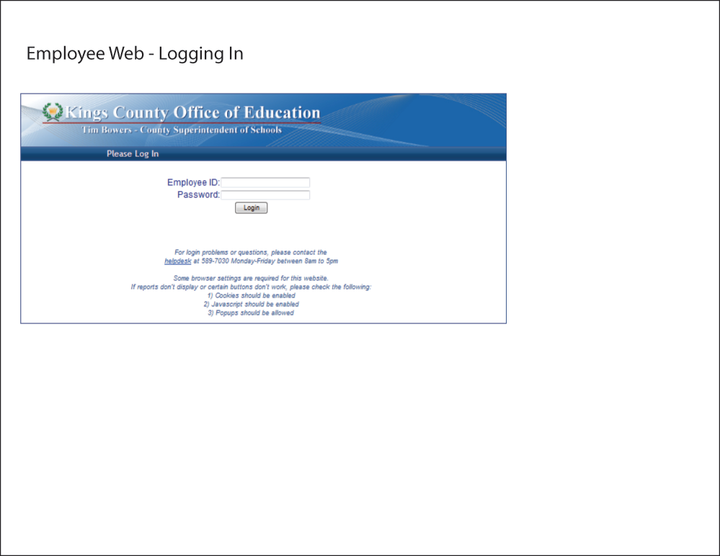
Notes:
There is one additional call out.
Employee ID – 5 digit employee number. Can be found on your paystub.
Password - last name the first time you log in

Slide 3
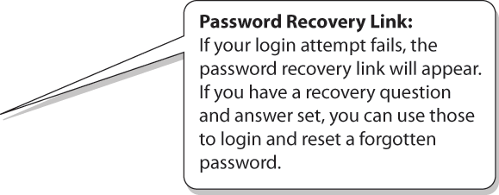
Password Recovery Set
The link to set or edit your recovery question and answer is located at the top of the employee information page.
Notes:
One additional call out.
Password Recovery link
Set Password Recovery question.

Slide 4
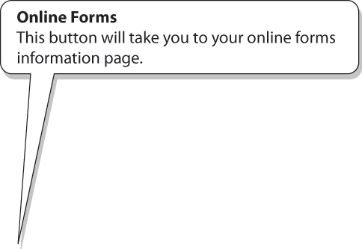
Completed forms and new forms are available here.
Notes:
There are two additional call outs.
Online forms button
Signature Information
Online form storage.

Slide 5
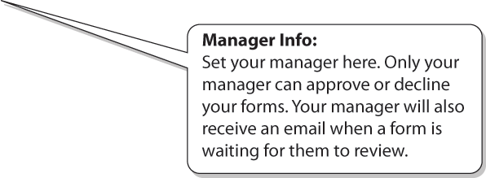
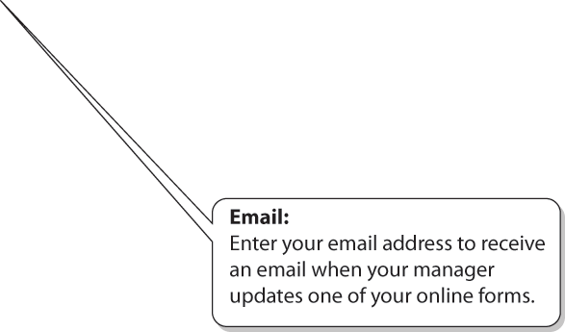
Notes:
Three additional call outs.
Signature Pin
If you do not remember your pin number you can change it here as well as setup a new pin.
The help desk will be unable to provide you with your pin number because we cannot see it.
Signature Image
Manager information.
If you have two managers you work with pick the primary manager here. When submitting a form you will be able to override the manager and select a different one.
Email.

Slide 6
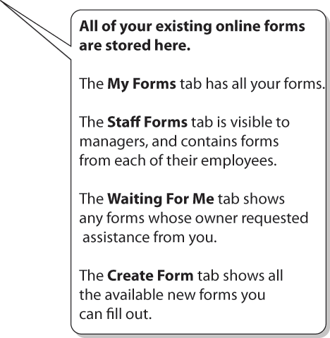
Notes:
There is one additional call out.
Discuss the forms page tabs.
My Forms
Staff Forms
Waiting For me
If someone has requested assistance from you to complete a form the form will show up in the tab “Waiting for me”
Create Form

Slide 7
Currently available forms can be found on the Create New Form tab.
Select APD Form to Add or Change your APD information.
Notes:
One additional call out
Create New form tab
2012-13 Work Day calendar.
Additional online forms include Per Diem Request, Travel Authorization and Expense Claim.
we just added the APD form that will allow you to setup Direct deposit of your payroll check.

Slide 8
1) Select the type for this APD request
2) Fill out Bank Information
3) Select Checking or savings

Slide 9
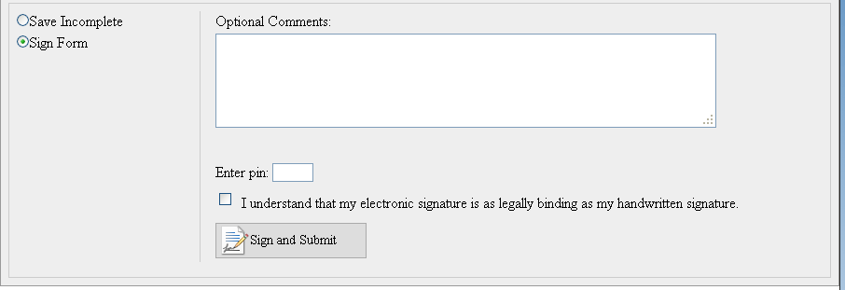
Use the Form Action tab in the toolbar to save or sign the form.
Choose Save Incomplete then click on the Save without Signing Button to save form and complete at a later time.
You Can add comments that can be viewed by the Payroll Department after form is signed and submitted.
Choose Sign Form from the list of form actions of the left.
Enter your pin number, check the signature agreement and click Sign and Submit to electronically sign the APD Form.

Slide 10
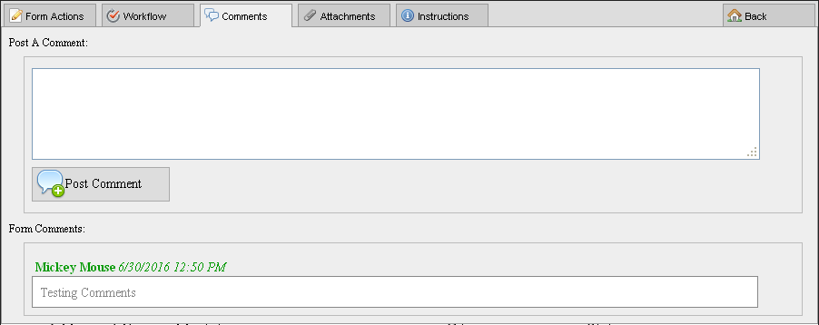
Workflow Tab shows the current status of the form and the next step if any.
Comments Tab will allow you to add additional comments or see existing comments for this form.

Slide 11
Attachment Tab will allow you to upload a document and view existing documents that are attached to current form.
Instruction Tab will have instructions for current form if available.
Notes:
New form we are working on will link the Absence system with Subfinder.
You can initiate an absence on either system and it will push the data to the other system.

